Slide 1
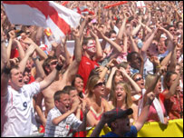
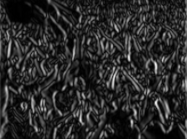
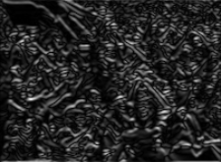
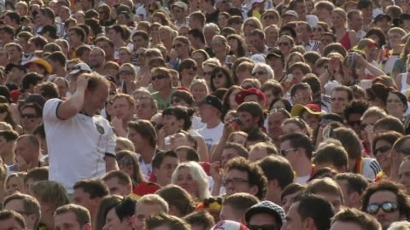
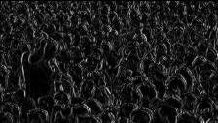
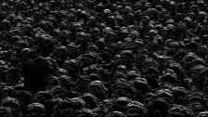
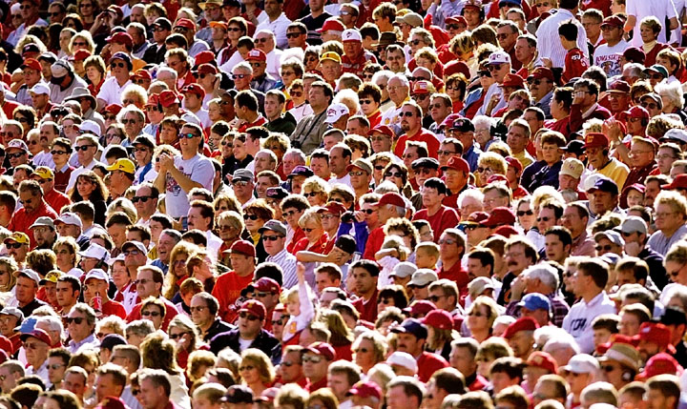
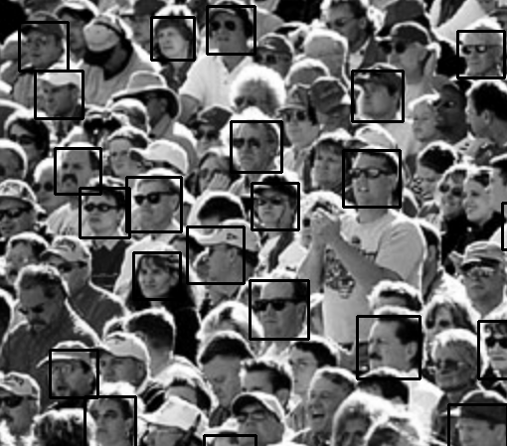
Crowd Behavior Recognition (Due 4/3/2015)
Sam Adams, Matt Keller, Tom McClenahan
Sample Input Image 1
Sample Input Image 2
Sample Input Image 3
Sample Result 2
Sample Result 3
Objective | %
Objective 1: Crowd Density | 10
Objective 2: Crowd Action (idle, booing, cheering) | 50
Objective 3: Crowd Emotion | 0
Cheeringness: 0.1185
(Vertical Sobel)
(Horizontal Sobel)
Techniques Used
Applying Sobel filter vertically and horizontally
Histogram of Oriented Gradients (HOG)
Face detection
Skin texture detection
(Vertical Sobel)
Cheeringness: -0.0039
(Horizontal Sobel)
Evaluation Metrics
Objective 1—can recognize sparse, dense crowds
Objective 2—“” idle, cheering, booing behaviors
Objective 3—“” angry, happy, bored emotions in crowds

